Slide 1
CSCI 3081
Simulation Model
By
Ben Ziebol and Jama Sheikh

Slide 2
Contents
The new feature that our team has implemented
- What is it?
- Why is this new feature important?
- Which design pattern did you use?

Slide 3
- What is it?
Cooling functionality and weather
  The packages will have temperature dependencies
  Weather will randomize during the simulation, varying the temperature of the environment.

Slide 4
- Why is this new feature important?
Real life implications
  In the real world, packages may need to remain in certain temperature ranges.
  This is a good proof of concept for accounting for such things
  By including the weather we can vary if a package needs to be chilled by a cooling station depending on the weather.

Slide 5
- Which design pattern did you use?
Weather
  Singleton, We want to have only a single instance of weather in the simulation
Cooling
  Decorator, since we want to edit the way that some packages are implemented while not changing the existing code.

Slide 6
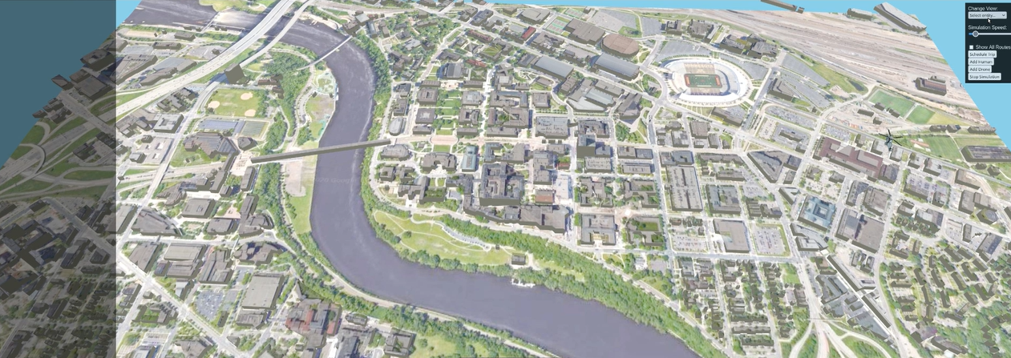
- Demo the feature

Slide 7
Generic script
Hello, I am [name] and I am [name], this is a simulation model. In the simulation model, there are multiple entities. It contains humans, a helicoptor, drones, robots, packages, and cooling stations. The simulation model represents the university of minnesota’s campus. The humans will wander around the map, the helicopter will fly above it. Meanwhile deliveries can be scheduled which will utilize the cooling stations, drones, packages, and robots to simulate the delivery.
For our simulation model we added the cooling stations and weather into the model. The cooling stations will cool packages in order to keep it cool and the weather will impact how much the packages will melt.
These features are important because in the real world, some packages will need to be kept at a certain temperature and as such simulating this for packages that need to be kept chilled is a good proof of concept which could be expanded upon by implementing a similar concept if it needs to b kept hot for example. The weather is needed since we want to account for various temperatures in the enviroment. For instance, if the weather outside is freezing the need to visit a cooling station isn’t needed while if it is 90 degrees out then a stop will need to be made.
For the cooling functionality we utilized decorators so that existing functionalites can simply be wrapped and utilizied
For the weather we implemented it as a singleton since we only want a single instance of it running at any time in the simulation.
Demo open up:
  Here you can see the basic layout of our simulation model, on the left is a notification window that will display a variety of information. For example: when a delivery is made or when the helicopter has traveled a mile
  The main focus of course is the UMN map itself with the buildings and roads
  Then here in the top right you can see the various different options that are availble to use
  [go through the different buttons]
  [show how to schedule a delivery and the different styles of path finding]
  [show how multiple drones can be supported and how the cooling station will be visited]
  [wrap up]

